Slide 1
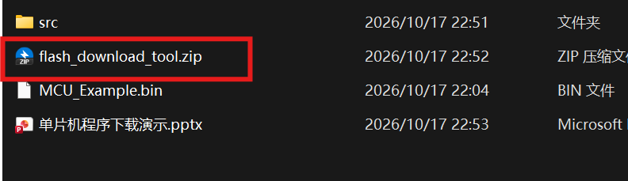
Extract the firmware download tool package flash_download_tool.zip

Slide 2
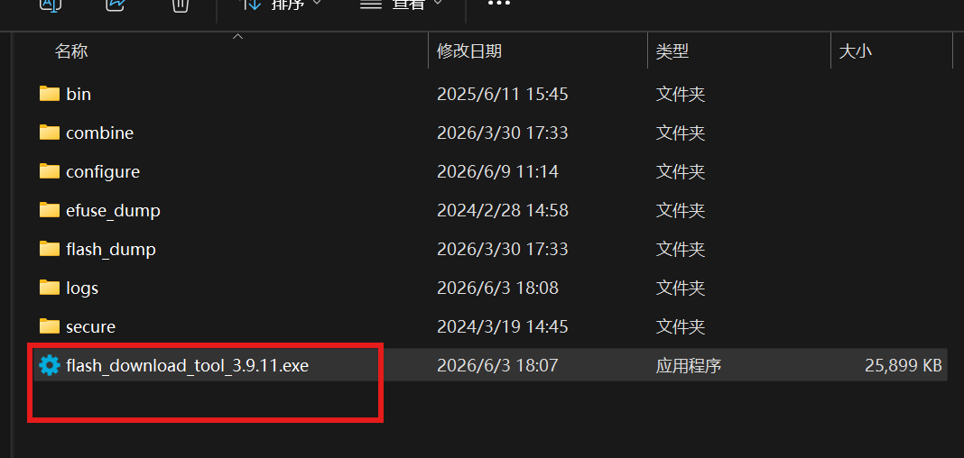
Run flash_download_tool_3.9.11.exe

Slide 3
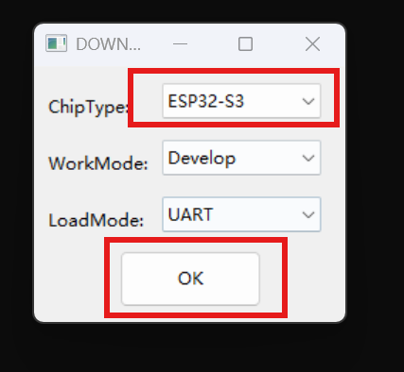
Select the ESP32-S3 chip and click OK.

Slide 4
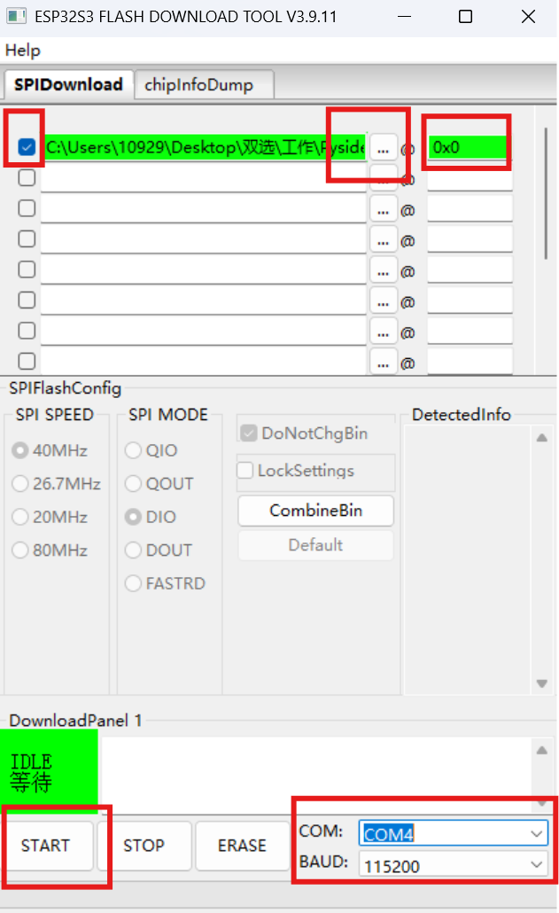
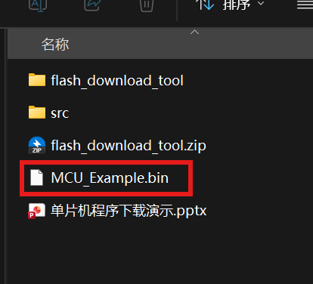
Select the MCU_Example.bin firmware file and set the address to 0x0.
Connect the microcontroller's COM port to the computer.
Select the microcontroller's COM port in the bottom-right corner of the flashing tool.
Click the START button to begin flashing.

Slide 5
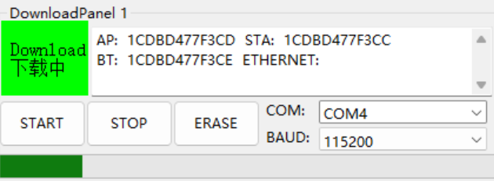
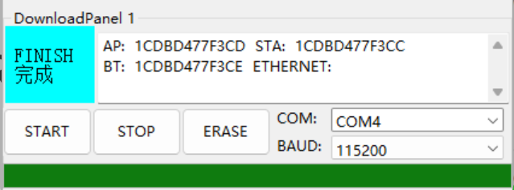
Wait for the progress bar to complete and for the "FINISH" prompt to appear.
Press the RST button on the microcontroller, or power-cycle it, to run the program.

